Slide 1
Motorcycle Airbag Safety Vest Initiative

Slide 2
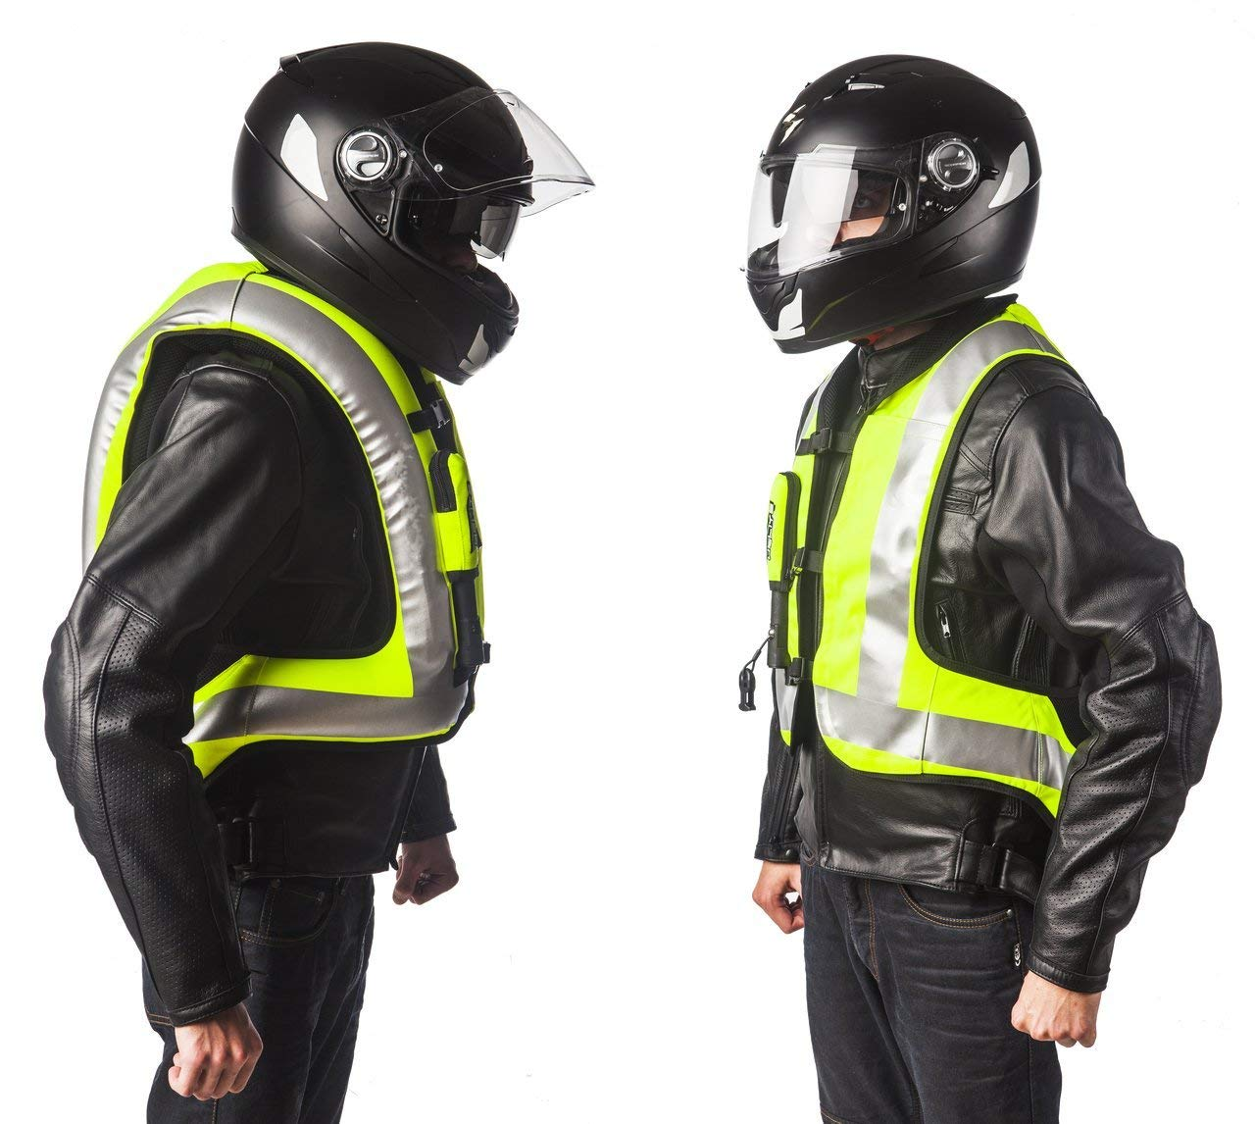
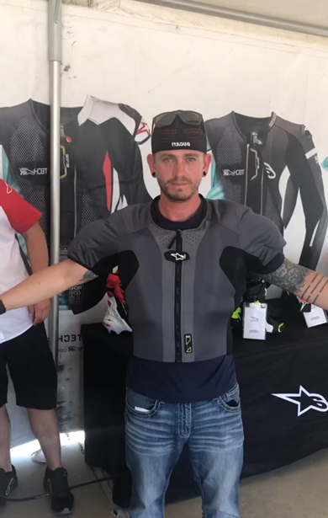
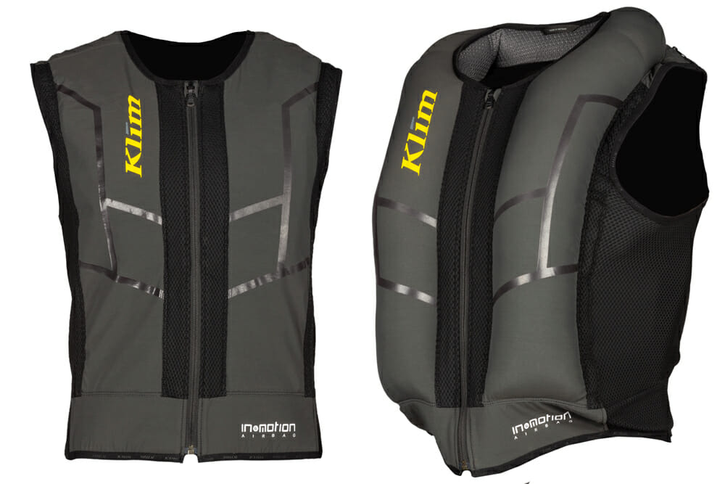
Airbag Safety Vest
Airbag Vest Styles
Tethered:
Put the trigger on a cord, fix the cord to the bike, and if you fall off, pop goes the airbag. This tech has been around the longest, and it’s well refined at this point. Some riders prefer the tether for its simplicity. They can usually be recharged by the rider at low cost, due to their basic design, and they don’t have batteries to recharge.
Electronic:
An algorithm-based system does not use a physical connection to the bike. It uses the rider, to determine when to deploy. With an array of sensors (gyros, accelerometers, GPS, and more) to detect impacts and deploy the airbag. A small computer monitors the rider’s condition up to 1,000 times per second.
Few Manufacturer Brands:
Dainese, Alpinestars, Helite, Merlin
Notes:
The triggering is provided either by a tether or electronic sensors (algorithm-based or artificial intelligence).
This inflatable gear slips on like a conventional jacket but will suddenly inflate with a burst of CO2 through its air bladders after a collision to provide additional protection for the rider who is thrown from his bike. Inflation with most models happens within milliseconds.
Newer models emphasize protection for the spine and may deploy without requiring a tether attachment to the motorcycle.
Cost of vest roughly average between 300$ - 1,000$

Slide 3
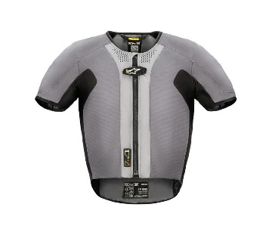
Why is this beneficial to you as a rider?
Airbag Safety Vest
140+ PMV-2 fatalities, and many more serious mishaps over the last 10-years resulting from blunt force trauma (BFT).
When a PMV-2 stops abruptly during a mishap, momentum can continue to the rider, causing ejection from the PMV-2, resulting in the rider striking another object at near the speed they left the PMV-2.
Sudden, blunt force impact to the head or torso often results in serious injury or death.
Notes:
Blunt Force Trauma is a primary contributing factor in serious mishap injuries and deaths.
Statistics indicate that forward momentum in a crash is reduced by roughly 60% for the rider in an airbag vest or jacket.
Head trauma is reduced by approximately 80%.
Riders have tested this gear on different surfaces and suffered a few bruises upon impact instead of broken bones, abrasions, or head and neck trauma.

Slide 4
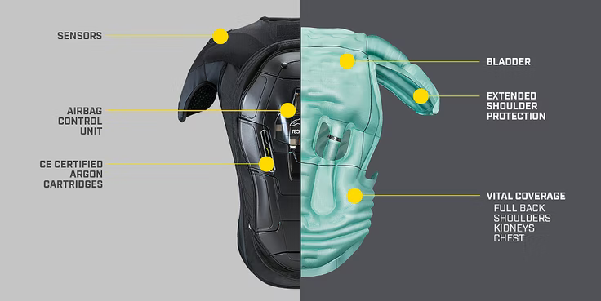
Why is this beneficial to you as a rider?
Airbag Safety Vest
From 2009-2019, 53.5K motorcycle deaths occurred in the United Stated. As a motorcycle rider, you are 29 times more likely to be killed in an accident than occupants of other vehicles.
Too expensive? Consider the cost of an ambulance ride or a helicopter trip if you were to crash and hurt yourself (or worse). That’s not even taking into consideration the cost of a hospital bill after you are mended and released.
Like any other piece of PPE, it won’t do anything to protect you if you’re not wearing it. It’s always better to have it and never have to use it, than the other way around.
Choose a vest that fits your needs as a rider and hope you never have to use it.
You can’t put a price on protecting your life!
Notes:
Nothing is 100% guaranteed to keep you from getting hurt (or worse) when you go down.
What do they protect? primarily the collarbones, vital organs, ribs, and back. Some even go so far as to cradle the neck.
Lower extremity injuries occurred in 47% of collisions.
Upper extremity injuries occurred in 40% of collisions.
Head injuries occurred in 35% of collisions.
Chest injuries occurred in 31% of collisions.
Spine injuries occurred in 20% of collisions.
Abdomen injuries occurred in 15% of collisions.
Face injuries occurred in 10% of collisions.

Slide 5
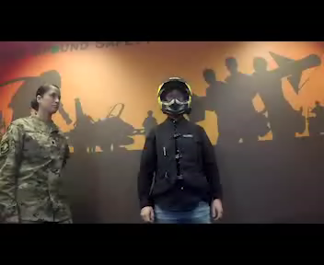
Airbag Vest Deployment Video
Notes:
Briefly explain what a Safety Vest is and show the video
If the video installed already shows practical donning, wear, and use of the vest, it can cover that briefing portion of the slides

